Slide 1

Reducing premature mortality from cardiovascular disease in Indonesia
Stéphane Verguet and David Watkins
Acknowledgements: William Garcia, Zili Huang, William Msemburi, & Yuchen Liu
September 1, 2026

Slide 2
Part 1. Summary of DCP-Indonesia preliminary analysis

Slide 3
PRELIMINARY ESTIMATES – NOT FOR QUOTATION OR CIRCULATION – UPDATED 30 AUG 2026
Key messages
New Key Messages from DCP Indonesia
CVD BURDEN
1
Cut CVD mortality by about one-third by 2050
Scale 7 basic CVD interventions plus tobacco control for about $9 more per person per year.
8%
of national income today
2
Use tobacco policy for rapid gains
WHO-recommended measures could save 1.2 million lives; even a modest 20% tobacco price increase could avert 700,000 CVD+NCD deaths by 2050.
Projected to reach
3
Move Indonesia toward peer-country outcomes
13% by 2050
The package falls below Malaysia’s current rates and the ASEAN average; reaching Singapore would require broader intersectoral action.
Higher than other conditions and peer countries
4
Make medicine access and financial protection central
CVD drives catastrophic spending for 1.7 million people yearly, concentrated among the poorest. Optimizing JKN delivery and supply-chain reforms are essential.
Source: Preliminary results from the World Bank Group with University of Washington and Harvard University
Notes:
•In Indonesia, the economic value of avoidable CVD mortality is 7.5% of national income and is projected to grow to 12.5% in 2050, far exceeding all other conditions and higher than peer countries.
•Improving access to a basic package of 7 CVD interventions plus tackling tobacco could reduce Indonesia’s CVD mortality rates to those of peer countries: preliminary estimates indicate that this package would reduce mortality by 25% and cost an additional $30 per person per year in health care costs by 2030. To achieve this, carry out a a gradual increase in access as well as availability and coverage for medicines and policies that reduce prices of medicines.
•Achieving WHO recommended levels of tobacco regulation and taxation would save 1.2 million lives and reduce mortality CVD by 7%. Even a 20% increase in tobacco price would reduce CVD deaths by 700,000 by 2050, not to mention benefits after 2050 from preventing other costly diseases such as cancer.
•After modeling 3 scenarios – just doing 70-70-70; adding tobacco control; and adding the rest of the CVD package – Indonesia can get close to Malaysia and below ASEAN average CVD mortality rate. However, to get to Singapore, additional intersectoral actions and expanding clinical package would be necessary.
•Addressing CVD would disproportionately benefit the poor in terms of financial protection, with 1.7 million people per year with catastrophic health expenditures (more than 10% income) due to CVD disease, of which 60-70% are among the poorest 20%. This large number comes from two areas – one is lack of access to prevention and the other is insurance implementation problems. Majority of financial risk comes from day-to-day expenditures on chronic medications currently paid of out-of-pocket.
•As proposed in JKN2 project, reforms in supply chain management and delivery systems of medicines are necessary to increase access and address the needs of the worst off.
•In addition the impact of tobacco control is pro-poor in terms of lives saved and financial protection, while also generating additional revenues largely from the rich (richest 60% generate 80% of the revenues).

Slide 4
Message 1. The economic value of reducing avoidable mortality is very large in Indonesia

Slide 5
question: What is the economic value of avoidable mortality FROM CVd?
Objective: To estimate the economic value associated with avoidable mortality related to various causes of death, over 2019-2050
We assess the monetary value of hypothetical reductions in cause-specific mortality
  We benchmark these hypothetical reductions against a mortality frontier (lowest mortality rates achieved) by cause
  We assign a willingness to pay value to these hypothetical reductions in cause-specific mortality
Key numéraire obtained:
% of income an individual is willing to pay to live 1 year under the lowest possible mortality rate for a given cause of death
Economic metric directly comparable to national annual incomes (GNI)

Slide 6
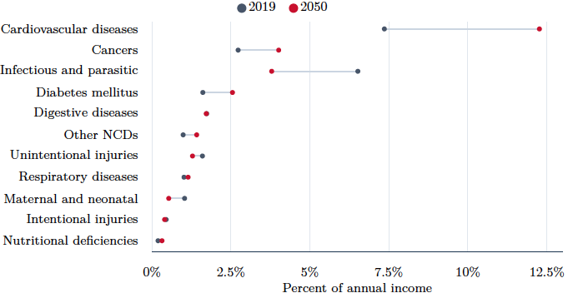
Indonesia’s economic value of avoidable mortality, 2019 & 2050

Slide 7
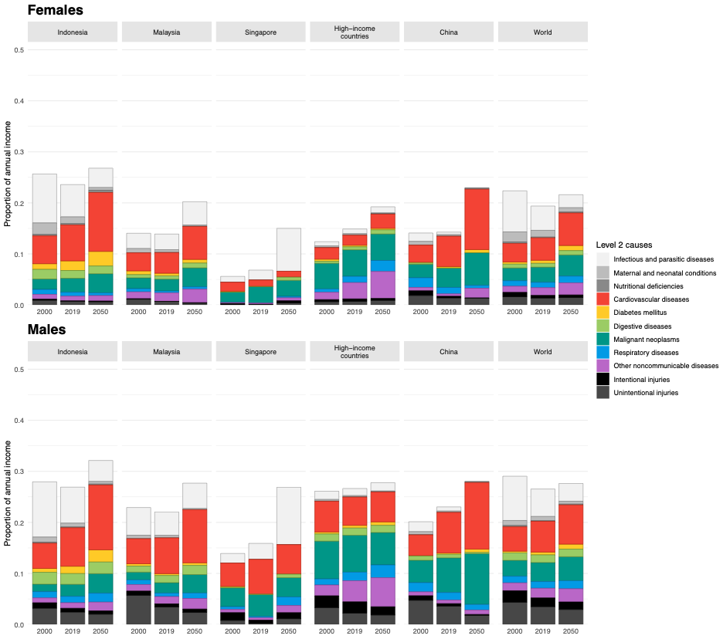
Economic value of avoidable mortality by cause,
Indonesia vs. selected comparators

Slide 8
Message 2. Improving access to a basic package of CVD interventions, and tackling tobacco, could reduce Indonesia’s CVD mortality rates to those of peer countries

Slide 9
question: What is the potential health impact of expanded access to basic CVD prevention and treatment?
Objective: To estimate the mortality impact of
  Expanded access (utilization) of a package of foundational interventions for CVD prevention (CKG) and treatment, including the “70-70-70” target
  Comprehensive tobacco control (WHO MPOWER policy package)
We assess the mortality consequences of these interventions, the associated increase in costs to JKN of expanded access, and the impact these would have on mortality rates relative to ASEAN comparators

Slide 10
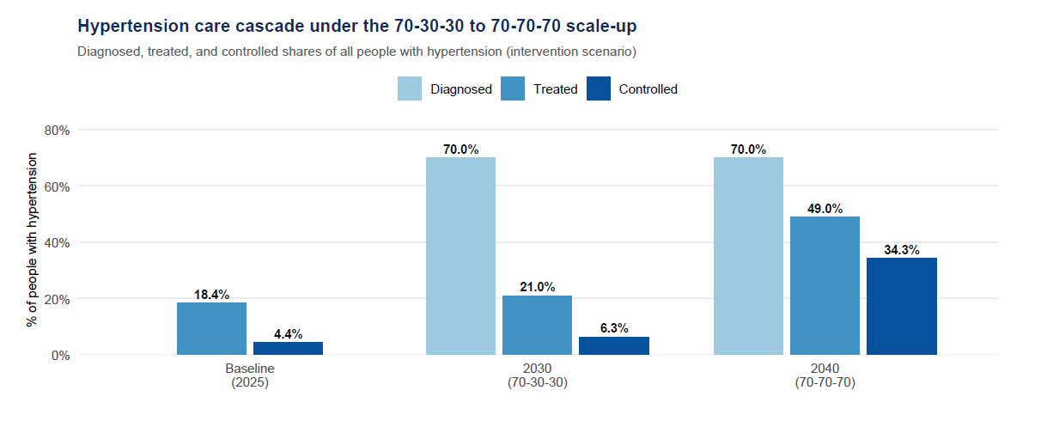
Framework for projecting the mortality impact and cost of achieving a 70-70-70 target for CVD prevention
Source: NCD Risk factors Collaborators 2024. Method: baseline (2025) shows only measured treated/controlled — diagnosis is not modeled at baseline, so no diagnosed bar. Type-2 diabetes follows the same targets (baseline treated ≈ 22.0%, controlled ≈ 7.5%).

Slide 11
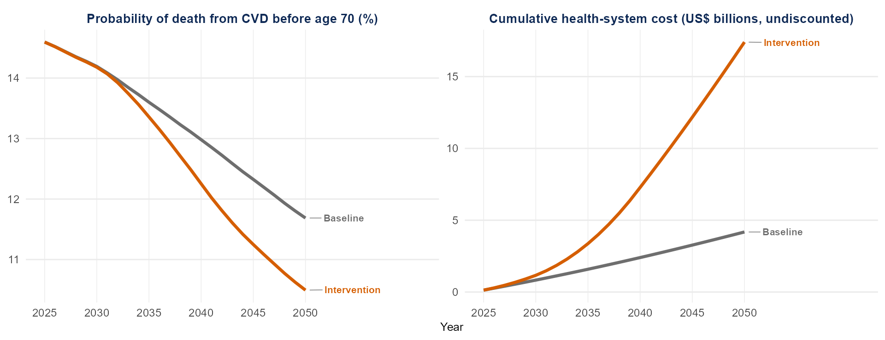
Achieving 70-70-70 lowers premature mortality at a rising but bounded cost
Sources: See previous slides for details of epidemiological and demographic inputs. Intervention unit costs come from Watkins et al., Lancet Global Health 2020. Note: The metric “probability of death from CVD before age 70” is calculated from life tables and is aggregated over the CVD causes modeled here.

Slide 12
Other interventions can add impact (and cost) to the
70-70-70 agenda
Clinical intervention | Cumulative deaths averted (millions) | Reduction in CVD mortality probability | Reduction in number of CVD deaths | Average annual additional | Additional cost per capita in 2050
 |  |  |  | cost per capita
Primary CVD prevention | 2.13 | 18.1% | 12.5% | US$4.1 | US$7.4
Type 2 diabetes care | 0.46 | 0.5% | 2.4% | US$1.6 | US$3.1
Treatment of acute heart attacks | 0.32 | 3.1% | 1.4% | US$1.7 | US$3.1
Heart attack secondary prevention | 0.16 | 1.6% | 0.7% | US$1.2 | US$2.2
Chronic heart failure care | 0.10 | 0.6% | 0.5% | US$0.7 | US$1.4
Treatment of acute heart failure | 0.07 | 0.6% | 0.3% | US$0.3 | US$0.6
Stroke secondary prevention | 0.04 | 0.3% | 0.1% | US$0.9 | US$1.6
All clinical (combined) | 3.18 | 23.4% | 17.1% | US$9.3 | US$16.7
Note: all interventions included here are based on recommendations from the Disease Control Priorities Project and represent a (high priority) subset of all interventions for CVD covered by JKN. Incremental costs and effects are calculated by assuming a linear scale-up to a target of 80% coverage by 2050. Costs are reported in market USD (2023) from the purchaser perspective.

Slide 13
Tobacco control policies would add significant impact to the clinical intervention packages
Type of policy | Cumulative deaths averted (millions) | Reduction in CVD mortality probability | Reduction in number of CVD deaths
Tobacco tax
50% increase in retail price | 0.95 | 5.2% | 3.3%
75% increase in retail price | 1.45 | 7.9% | 7.1%
Tobacco policy package (MPOWER) | 0.65 | 3.6% | 2.2%
Combined impact of taxes (75%) and regulations | 2.07 | 11.2% | 4.2%
Note: tobacco policies are assumed mostly to have an effect on CVD incidence and case-fatality from cessation among persons without and with CVD, respectively. Impact estimates are based on price-elasticity meta-analyses and relative risks from the GBD study. *The tobacco regulations are the non-price measures in WHO’s MPOWER package: smoke-free policies, health warnings and mass-media campaigns, advertising bans, and cessation support. Only 6 CVD causes and T2DM are included; results may differ from message 4, which includes 19 CVD + Cancer + EPOC + T2DM causes.
Impact continues to grow beyond 2050 from reduced smoking prevalence among today’s younger people

Slide 14
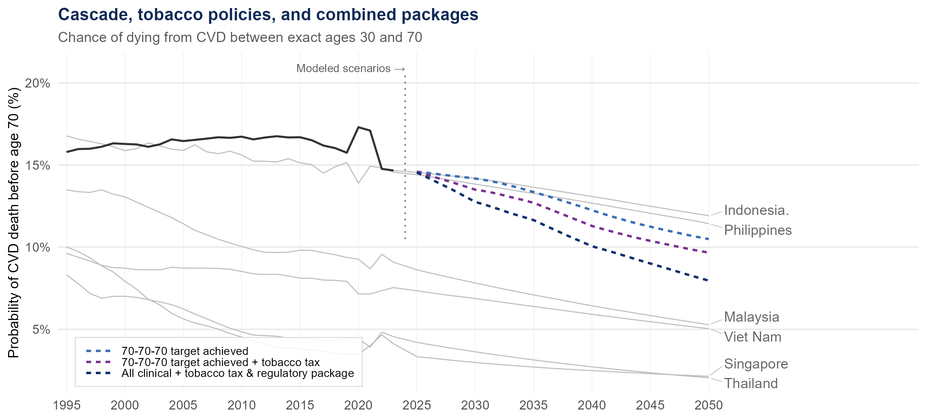
Implementation of clinical interventions and tobacco control could get Indonesia close to Malaysia’s CV mortality by 2050
But achieving Singapore-level mortality would require more actions on prevention (e.g., lead abatement, air pollution control) and treatment (novel CVD therapies)
Notes:
Note: Indonesia observed history (solid, to 2023) and ASEAN comparators are WPP-scaled reference series. Modeled Indonesia scenarios (dashed, 2025-2050) use the GBD-calibrated model baseline. ASEAN comparator trends correspond to a linear extrapolation for illustrative reference. Tobacco policy impacts correspond to a 75% retail price increase scenario.

Slide 15
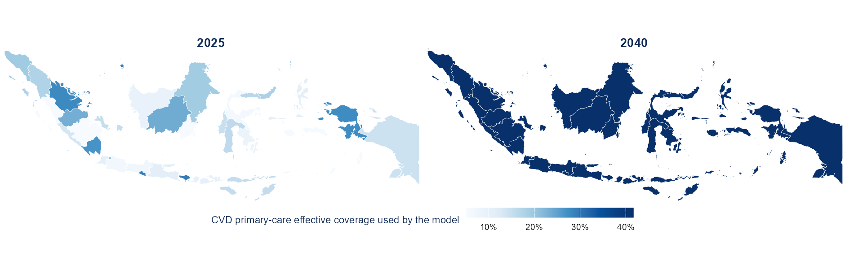
Achieving 70-70-70 would require differential action at the provincial level to close gaps
Method and data: See previous slides for basics of modeling. The Indonesia national-level disease and demographic models are re-parameterized with provincial-level all-cause and CVD-specific mortality (from GBD and UNPD) to create unique models for each province that are re-calibrated. Note: Provincial CVD treatment coverage is a crude anchor based on observed CVD mortality and the modeled coverage-effect relationship (extreme values capped); provincial diabetes coverage is scaled proportionally. These values must be validated with BPJS before policy use.

Slide 16
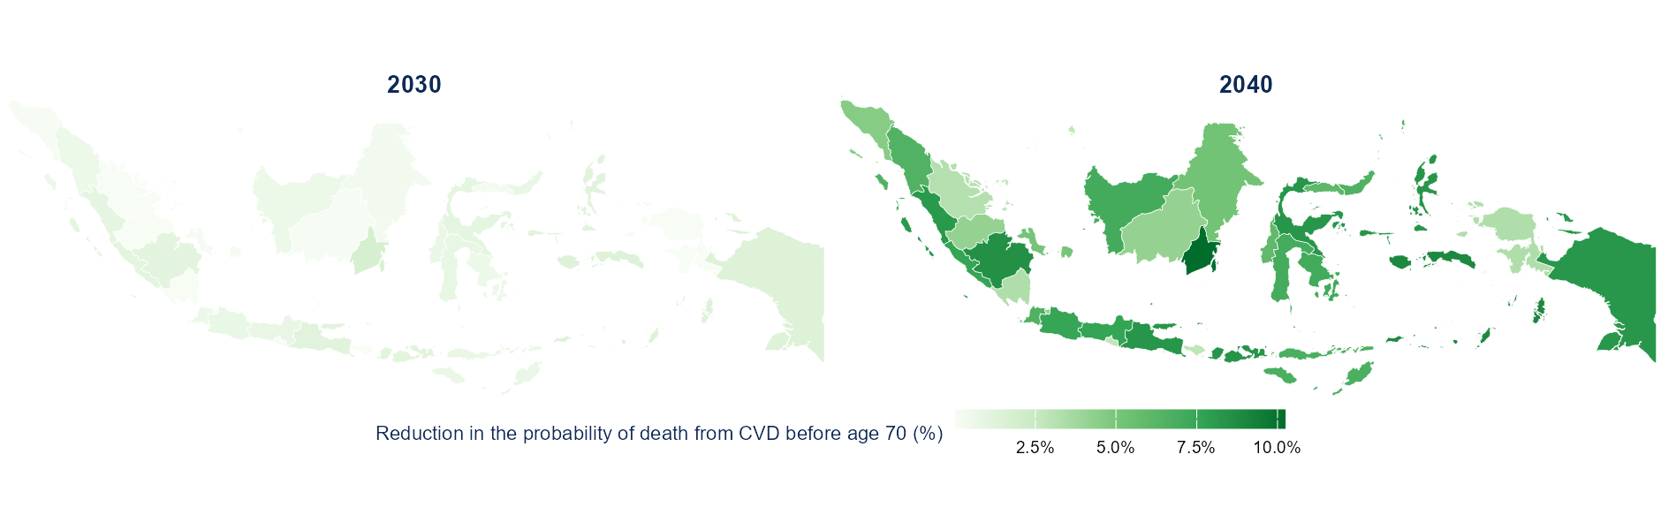
Achieving 70-70-70 would cause premature CVD mortality to fall in every province by 2040
See previous slides for relevant methods and data

Slide 17
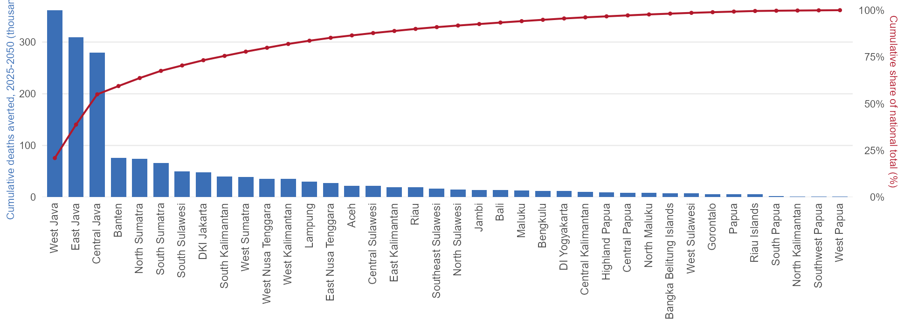
About half of averted CVD deaths come from the three most populous provinces
Note: This Pareto chart contains bars that represent cumulative deaths averted 2025–2050 by province as per the analysis presented in the previous slides. The red curve is the running cumulative proportion of total deaths averted at the national level. See notes on previous slides for other methods and data.

Slide 18
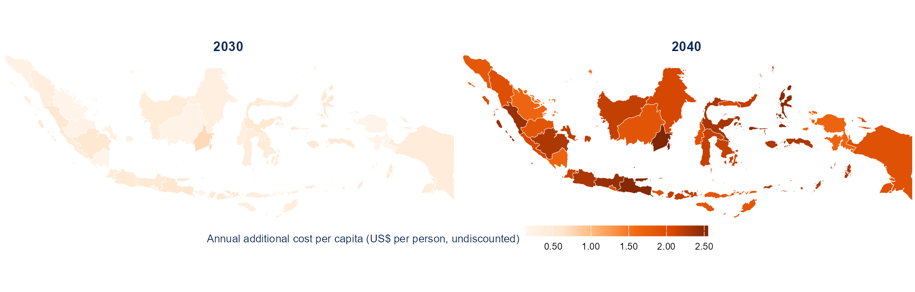
70-70-70 has a different financing requirement according to provincial burden and access gap
Note: The map above shows the average annual additional cost per capita required over the 2025-2050 period to reach the 70-70-70 target in each province. The costs vary depending on the current utilization (effective coverage) of CVD preventive interventions and magnitude of CVD burden in each province. Unit costs are assumed to be the same across provinces; this requires validation with BPJS.

Slide 19
Message 3. The financial risk protection implications of CVD are considerable

Slide 20
question: What are the FINANCIAL CONSEQUENCES OF CVD FOR INDONESIAN HOUSEHOLDS?
Objective: To estimate the lack of financial risk protection associated with chronic care and acute events associated with CVD
We assess the number of cases of catastrophic health expenditures associated with out-of-pocket costs related to CVD care under different scenarios under JKN

Slide 21
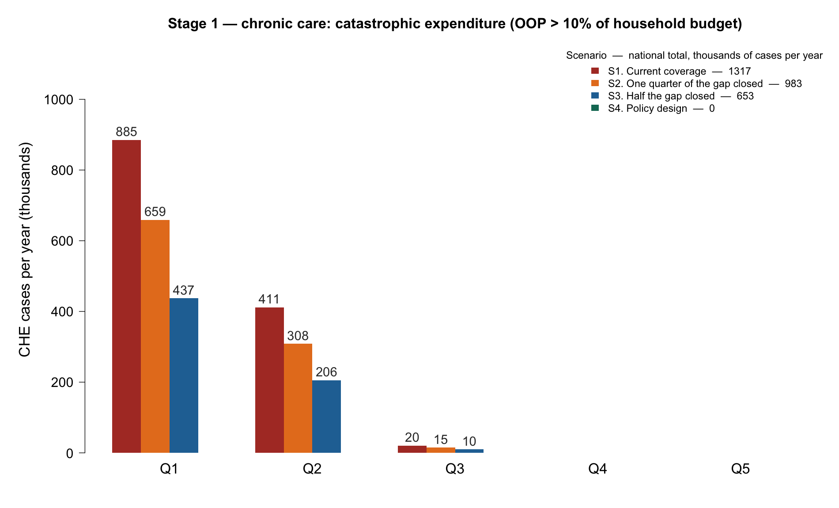
Key finding 1: Chronic care
1.3 million catastrophic cases per year = 8% of 15.6M patients in care
Two thirds of them in Q1 consumption quintile
Catastrophic health expenditure (CHE) cases
(OOP costs > 10% of household expenditure) related to chronic care

Slide 22
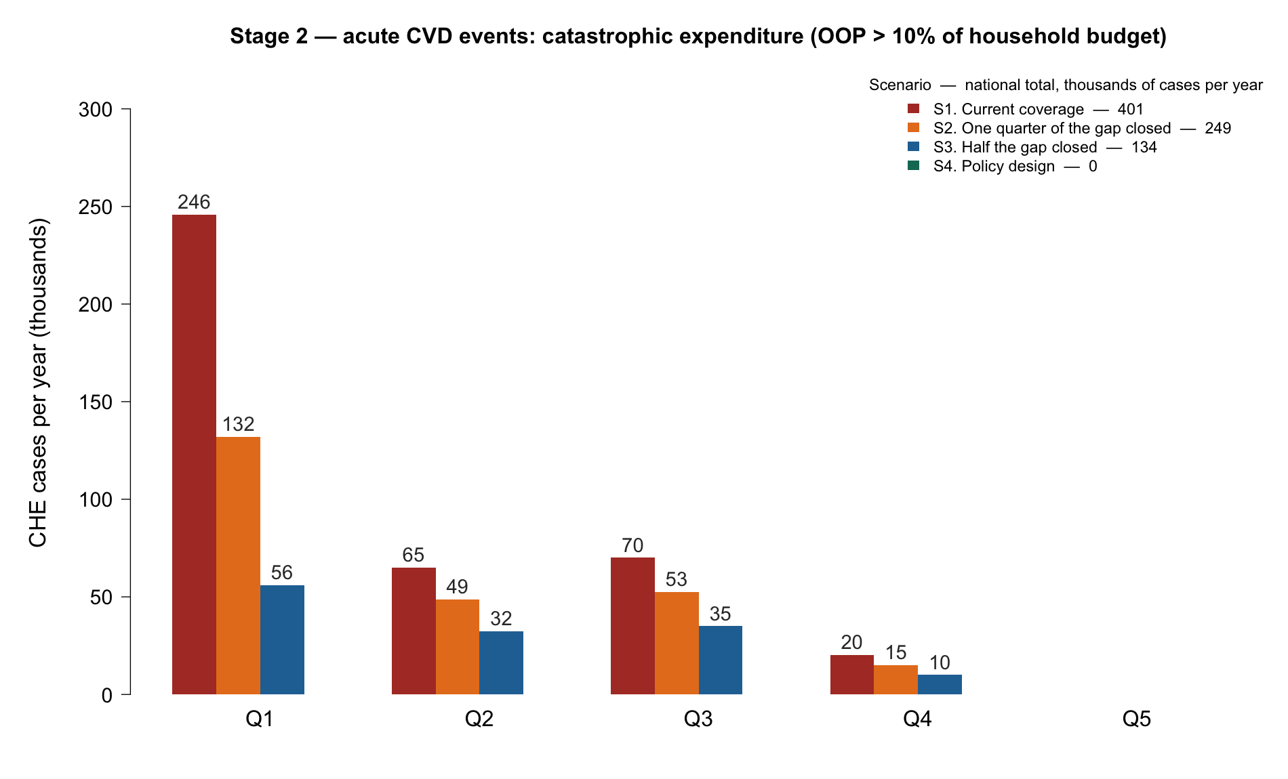
Key finding 2: Acute events
401,000 catastrophic admissions a year = 22% of all CVD admissions
62% of those in Q1
Catastrophic health expenditure (CHE) cases
(OOP costs > 10% of household expenditure) related to acute care

Slide 23
Brief summary: Four scenarios and corresponding catastrophic health expenditure (CHE)
Raising coverage toward original policy design
Scenario | National average coverage chronic / acute | Chronic CHE cases per year | Acute CHE cases per year | Total CHE cases per year
S1. Current coverage | 40% / 54% | 1,316,821 | 401,099 | 1,717,920
S2. One quarter of the gap closed | 53% / 64% | 982,559 | 248,508 | 1,231,067
S3. Half the gap closed | 67% / 75% | 652,988 | 133,623 | 786,611
S4. Policy design: coverage fully delivered | 100% / 100% | 0 | 0 | 0
Note: CHE cases per year at a 10% threshold of annual consumption expenditures

Slide 24
Message 4. Tobacco tax hikes have a pro-poor impact & bring large fiscal revenues

Slide 25
question: What are the health and financial consequences of increased tobacco taxes in Indonesia?
Objective: To estimate the health gains, financial risk protection benefits, and fiscal revenues raised with different scenarios of increased tobacco taxes
We assess the distributional impact on mortality reduction, on reducing the number of cases of catastrophic health expenditures associated with out-of-pocket costs related to treatment of tobacco-related diseases, and the revenues raised
Adapted from: Lisus, Roy, et al. Forthcoming; Verguet, Gauvreau et al. Lancet Global Health 2015

Slide 26
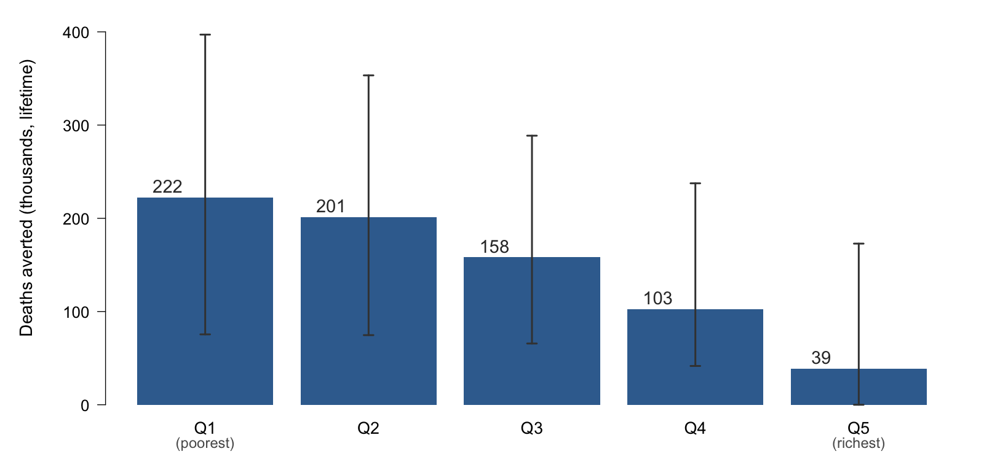
Key finding 1: Health gains are large & pro-poor
724,000 premature deaths averted; 60% in Q1 & Q2
50% increase in excise tax
Note: 19 tobacco-related conditions (incl. cardiovascular 58%, COPD 15%, lung cancer 14%, diabetes 5%) covering 85% of Indonesia's smoking-attributable deaths; tuberculosis and respiratory infections not yet included, so this is conservative. 95% uncertainty intervals (n= 2,000 Monte Carlo draws).

Slide 27
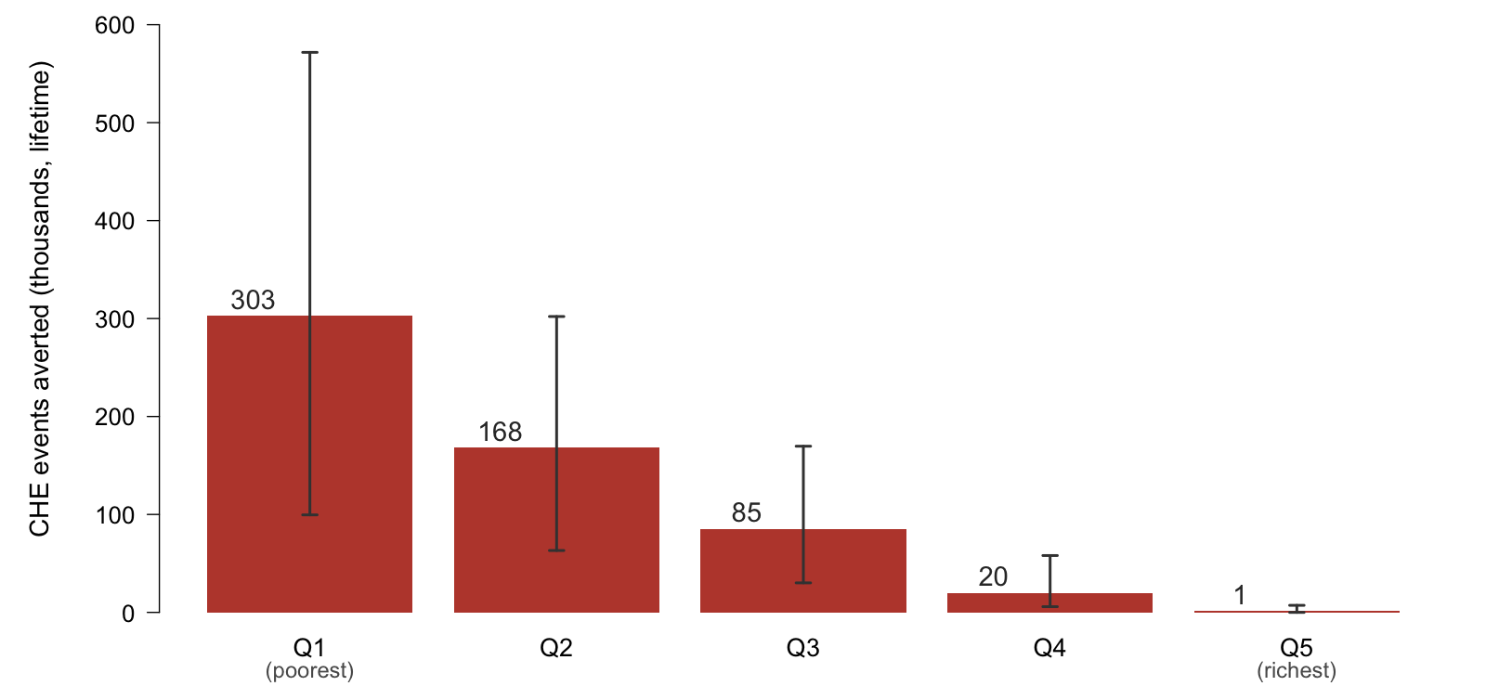
Key finding 2: Financial protection gains are large & pro-poor
577,000 catastrophic cases averted, 82% in Q1 & Q2
50% increase in excise tax
Note: Catastrophic health expenditure (CHE) cases defined as an out-of-pocket payment above 10% of annual household consumption expenditure. 95% uncertainty intervals (n= 2,000 Monte Carlo draws).

Slide 28
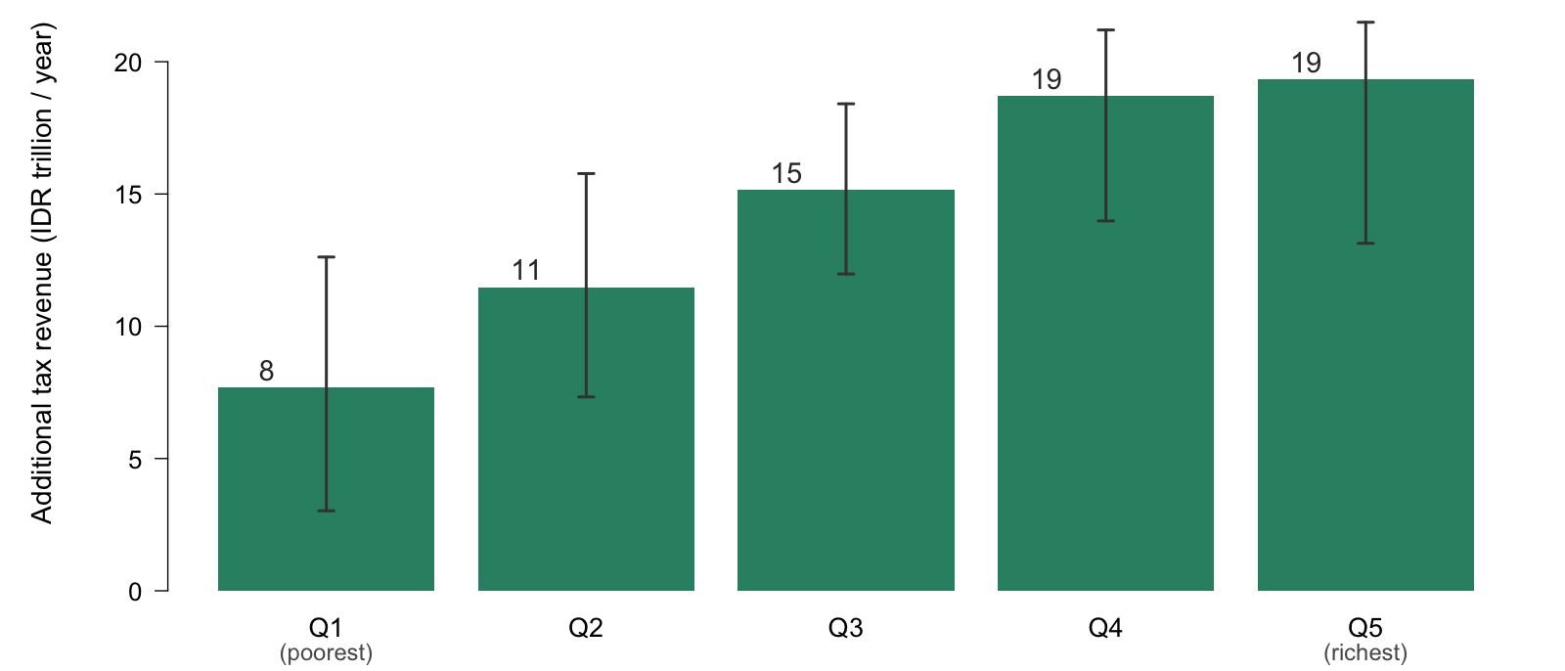
Key finding 3: Fiscal revenues raised are large & accrue among the rich
Revenues rise by 31%; Q5 pays 27% of it
50% increase in excise tax
Note: National total IDR 72T per year. An annual flow in a single steady-state year, not a lifetime total. In US dollars: Q1 480, Q2 717, Q3 947, Q4 1,169, Q5 1,209 million; total US$4,522 million per year. 95% uncertainty intervals (n= 2,000 Monte Carlo draws).

Slide 29
Part 2. Plans for capacity-building for BKPK modeling unit

Slide 30
Overview of training program modules
Foundational lectures
  Introduction to health economics and economic evaluation
  Decision analysis and mathematical modeling
  Equity and financial protection metrics
  Extended cost-effectiveness analysis
Training on Indonesia CVD model
  Economic value of avoidable mortality
  Orientation to demographic-epidemiological model
  Clinical intervention modeling (cost-effectiveness)
  Tobacco and other risk factor modeling
  Financial protection modeling

Slide 31
Proposed structure of each module
45-minute lecture
15-minute Q&A
Break
30-min hands-on exercise
30-min group discussion and feedback

Slide 32
Proposed timeline
October 2026
foundational lectures (part 1 of 2)
November 2026
foundational lectures (part 2 of 2)
December 2026
launch of modeling unit
January 2027
training on CVD model (part 1 of 3)
February 2027
training on CVD model (part 2 of 3)
March 2027
training on CVD model (part 3 of 3)

Slide 33
Thank you

